Slide 1
Final Delivery

Slide 2
Progress Between Deliveries
1

Slide 3
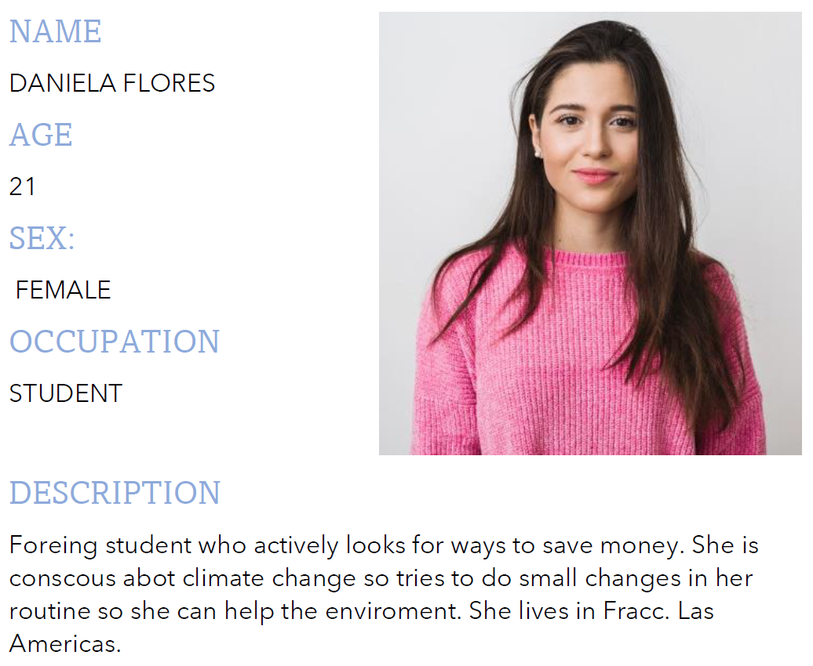
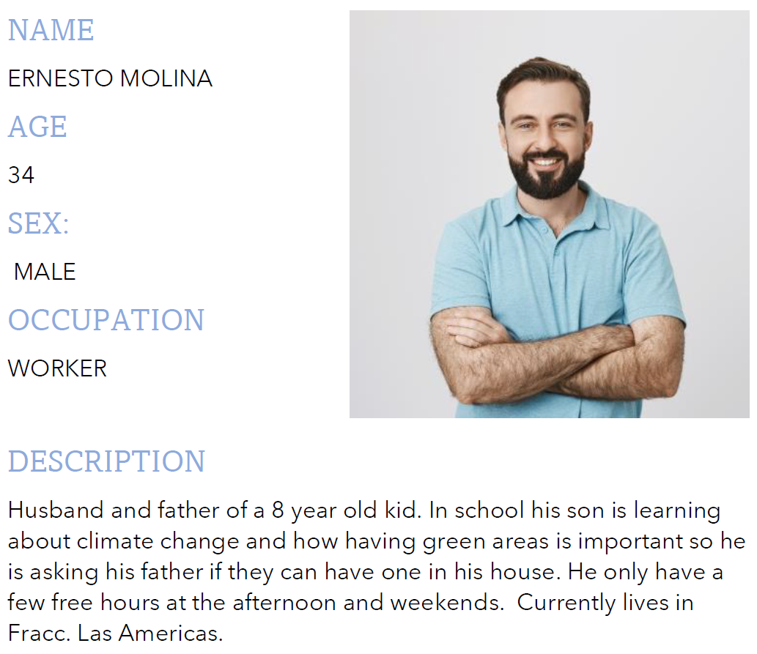

First Delivery
Social Problem defined
“Green areas in small spaces”
An interactive platform to spread information and possible solutions
Personas
Investigation
Interview Questions

Slide 4
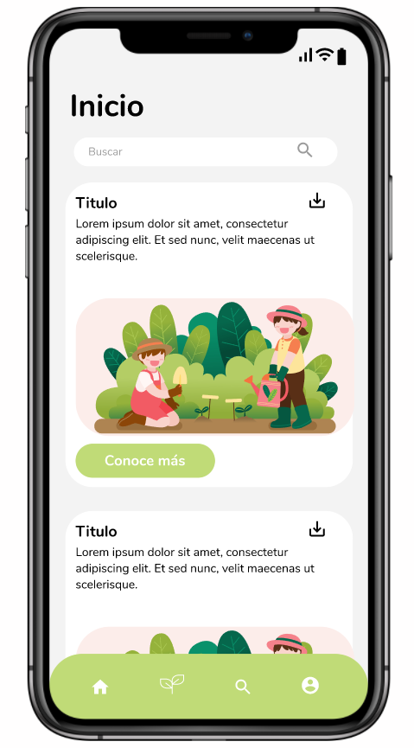
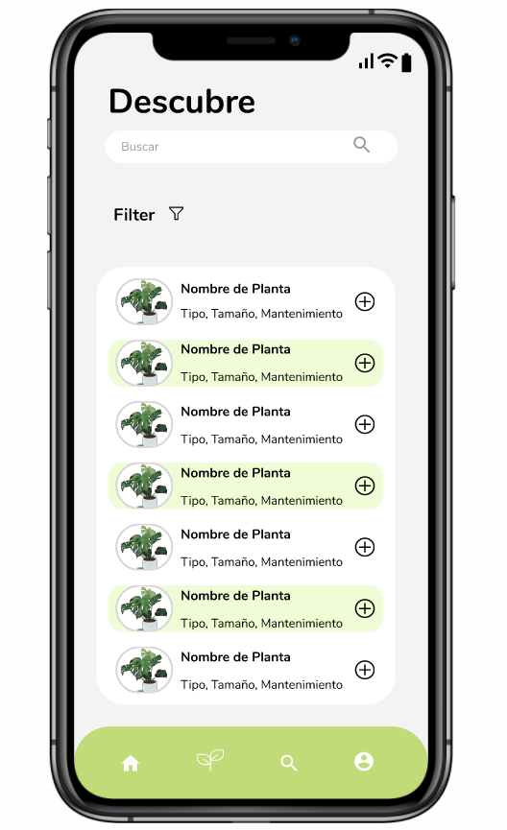
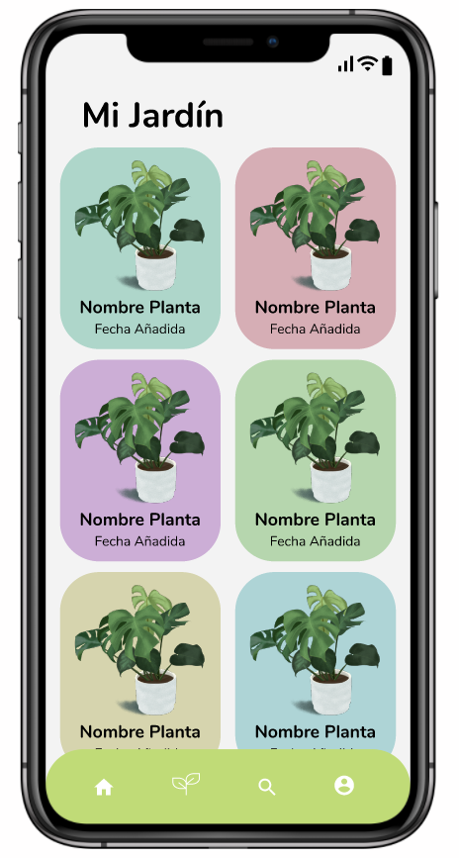

Second Delivery
Interviews for requirements
Interested in apps to facilitate making
4 of 8 interviewed want simple information
The interviewed says is difficult to find information
Everyone want a catalog with important information.
Requirements to make prototypes

Slide 5
Final Delivery
Usability testing
First, we tried to test learnability.
Then, we decided to test Easy to use.
Making a intuitive design for the users.
3 activities:
-Add any plant to the garden.
-Add a plant searching the name.
-add a plant using filters
Results:
-The first time in the app, the users have a some problem to find the catalog.
The first user failed 5 times, the second user failed 3 times.
- anyone spend much time per task.
- we need better icons to represent all section.

Slide 6
Our Project Development
2

Slide 7

Our Process
Define Problem
Collect Information
Define Our Solution
Measure Prototypes
Create Prototypes

Slide 8
That is Produced?
Interviews
Personas
Prototypes
Tests

Slide 9
What was the results?
The problem was defined thanks to the investigations
The solution was proposed through interviews

Slide 10
What was the results?
The prototypes were obtained based on the "Personas" and the requirements
Tests were obtained based on the prototypes

Slide 11
Usability Testing
3

Slide 12


Tests Performed
Ease of use
Intuitive

Slide 13
How do we did it?
Found a user to test with our prototypes.
Give him three activities to complete in the app.
Observe his steps, measure times and hear feedback.
Analyze data and see how well it worked.

Slide 14
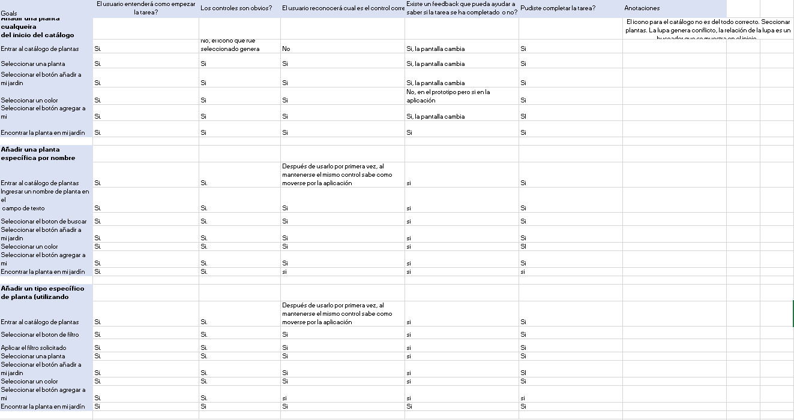
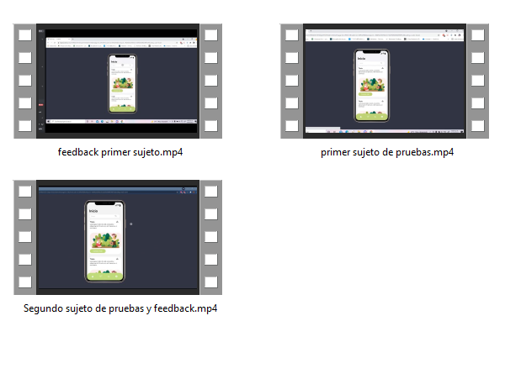
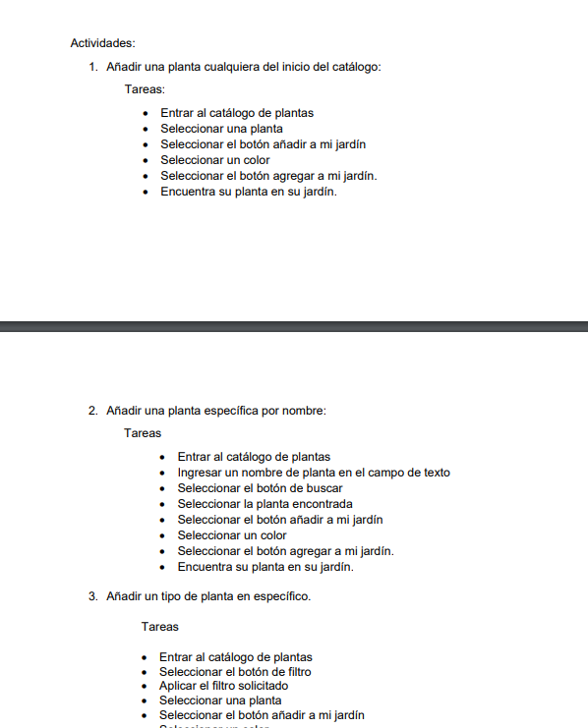
Evidences
Videos of the test being performed
Reports and written material during test

Slide 15
Results
“The icon used for the catalog is confusing”
“Once you start using the application it is very intuitive it guides you”
The results we got were very positive with low errors and also keeping in the time limits we set.

Slide 16
Developmental Learning
4

Slide 17
We learned to substantiate the problem
We learned to find our innovative solution to the problem research

Slide 18
We learned to determine our target audience
We learned to make the product more accessible to the consumer

Slide 19
We learned the importance of validating our ideas with users
We learned how to focus on the user for development

Slide 20
Teamwork Performance
5

Slide 21
Defined Roles?
Having a team leader
Work as a team
Helped us

Slide 22
OUR Past METRICS
First Delivery
Responsibility
Proactivity
Productivity
General Project Knowledge
Second Delivery
Presentations
Document in charge
Meetings
Present

Slide 23
For this iteration, our metrics
This video
Meetings
Evidences

Slide 24



How our team WORKED
Communication
Meetings
Creativity

Slide 25
Thanks!
Any questions?
You can find more information at:
https://github.com/Josema29/HCI

